Slide 1
Risk Management
Problems that haven’t happened yet
Why is it hard?
Some are wary of bearing bad news
  No one wants to be the messenger
  Or seen as “a worrier”
You need to define a strategy early in your project
Q7503, Summer 2002

Slide 2
Risk Management
Identification, Analysis, Control
Goal: avoid a crisis
Thayer: Risk Mgmt. vs. Project Mgt.
  For a specific vs. all projects
  Proactive vs. reactive
Q7503, Summer 2002

Slide 3
Project Risk
Characterized by:
  Uncertainty (0 < probability < 1)
  An associated loss (money, life, reputation, etc)
  Manageable – some action can control it
Risk Exposure
  Product of probability and potential loss
Problem
  A risk that has materialized
Q7503, Summer 2002

Slide 4
Types of Risks
Schedule Risks
    Schedule compression (customer, marketing, etc.)
Cost Risks
    Unreasonable budgets
Requirements Risks
    Incorrect
    Incomplete
    Unclear or inconsistent
    Volatile
Q7503, Summer 2002

Slide 5
Types of Risks
Quality Risks
Operational Risks
Most of the “Classic Mistakes”
  Classic mistakes are made more often
Q7503, Summer 2002

Slide 6
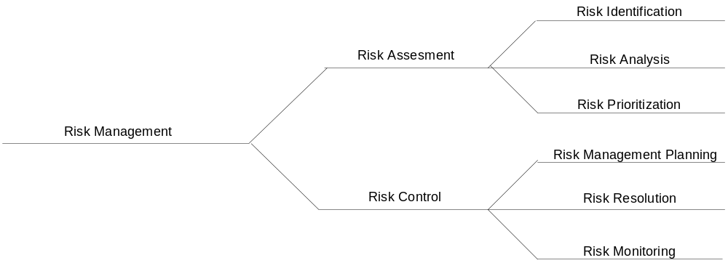
Risk Management Process
“Software Risk Management”, Boehm, 1989
Q7503, Summer 2002

Slide 7
Risk Identification
Get your team involved in this process
  Don’t go it alone
Produces a list of risks with potential to disrupt your project’s schedule
Use a checklist or similar source to brainstorm possible risks
Q7503, Summer 2002

Slide 8
Risk Analysis
Determine impact of each risk
Risk Exposure (RE)
    a.k.a. “Risk Impact”
    RE = Probability of loss * size of loss
    Ex: risk is “Facilities not ready on time”
      Probability is 25%, size is 4 weeks, RE is 1 week
    Ex: risk is “Inadequate design – redesign required”
      Probability is 15%, size is 10 weeks, RE is 1.5 weeks
    Statistically are “expected values”
    Sum all RE’s to get expected overrun
      Which is pre risk management
Q7503, Summer 2002

Slide 9
Risk Analysis
Estimating size of loss
    Loss is easier to see than probability
      You can break this down into “chunks” (like WBS)
Estimating probability of loss
    Use team member estimates and have a risk-estimate review
    Use Delphi or group-consensus techniques
    Use gambling analogy” “how much would you bet”
    Use “adjective calibration”: highly likely, probably, improbable, unlikely, highly unlikely
Q7503, Summer 2002

Slide 10
Risk Prioritization
Remember the 80-20 rule
Often want larger-loss risks higher
  Or higher probability items
Possibly group ‘related risks’
Helps identify which risks to ignore
  Those at the bottom
Q7503, Summer 2002

Slide 11
Types of Unknowns
Known Unknowns
  Information you know someone else has
Unknown Unknowns
  Information that does not yet exist
Q7503, Summer 2002

Slide 12
Risk Control
Risk Management Plan
  Can be 1 paragraph per risk
  McConnell’s example
Q7503, Summer 2002

Slide 13
Risk Resolution
  Risk Avoidance
    Don’t do it
    Scrub from system
    Off-load to another party
      McConnell: design issue: have client design
  Risk Assumption
    Don’t do anything about it
    Accept that it might occur
    But still watch for it
Q7503, Summer 2002

Slide 14
Risk Resolution
  Problem control
    Develop contingency plans
    Allocate extra test resources
    See McConnell pg. 98-99
  Risk Transfer
    To another part of the project (or team)
    Move off the critical path at least
  Knowledge Acquisition
    Investigate
      Ex: do a prototype
    Buy information or expertise about it
    Do research
Q7503, Summer 2002

Slide 15
Risk Monitoring
Top 10 Risk List
    Rank
    Previous Rank
    Weeks on List
    Risk Name
    Risk Resolution Status
A low-overhead best practice
Interim project post-mortems
  After various major milestones
McConnell’s example
Q7503, Summer 2002

Slide 16
Risk Communication
Don’t be afraid to convey the risks
Use your judgment to balance
  Sky-is-falling whiner vs. information distribution
Q7503, Summer 2002

